Slide 1
File Management

Slide 2
Index
Definition of File
File and related terms
Purpose of File Management
Operations on File
File Allocation Methods
File Organization

Slide 3
What is File?
A file is a collection of related information defined by its creator.
Files represent programs (both source and object forms) and data.
The operating system is responsible for the following activities in connections with file management:
  File creation and deletion.
  Directory creation and deletion.
  Support for manipulating files and directories.
  Mapping files onto secondary storage.
  File backup on stable (non-volatile) storage media.
  Identify and locate a selected file
  Use a directory to describe the location of all files plus their attributes
  On a shared system describe user access control
  Blocking for access to files
  Allocate files to free blocks
  Manage free storage for available blocks.

Slide 4
Purpose of File Management
The file manager handles all files on secondary storage media.
To perform these tasks, file management must:
  be able to identify the numerous files by giving unique names to them
  maintain a list telling where exactly each file is stored, how many sectors on the medium it occupies, and in which order those sectors make up the file
  provide simple and fast algorithms to read and write files
  give and deny access rights on files to users and programs
  allocate and deallocate files to processes
  provide users and programs with simple commands for file handling

Slide 5
Allocation Methods
Contiguous file allocation
Linked allocation
Indexed allocation

Slide 6
Methods of File Allocation
Contiguous allocation
  Single set of blocks is allocated to a file at the time of creation
  Only a single entry in the file allocation table ( Starting block and length of the file )
  Suffers internal fragmentation issues
  External fragmentation will occur
  Need to perform compaction
  It allows fast access of the files but memory management is poor

Slide 7

Methods of File Allocation

Slide 8
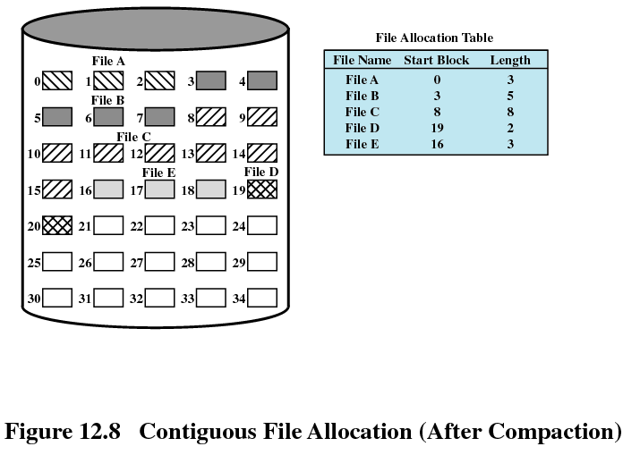
Methods of File Allocation

Slide 9
Methods of File Allocation
Linked allocation
  Allocation on basis of individual block
  Each block contains a pointer to the next block in the chain
  No external fragmentation
  Best for sequential files
  Only single entry in the file allocation table
    Starting block and end block of the file

Slide 10
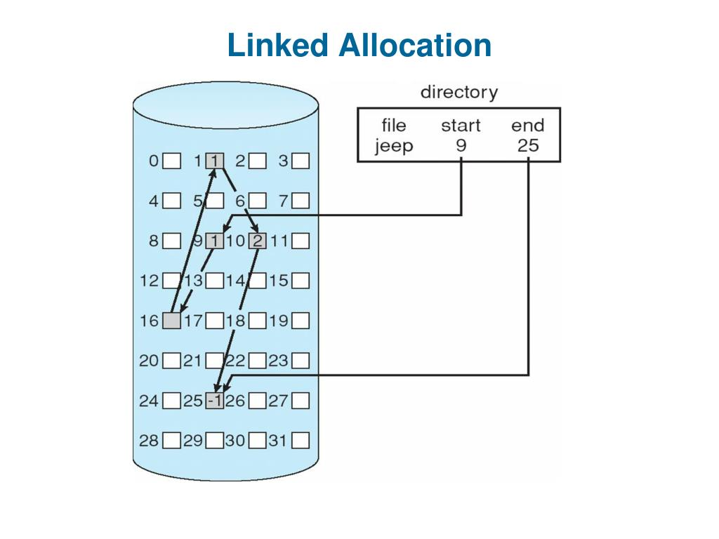
Methods of File Allocation

Slide 11
Methods of File Allocation
Indexed allocation
  File allocation table contains a separate one-level index for each file
  The index has one entry for each portion allocated to the file
  The file allocation table contains block number for the index

Slide 12
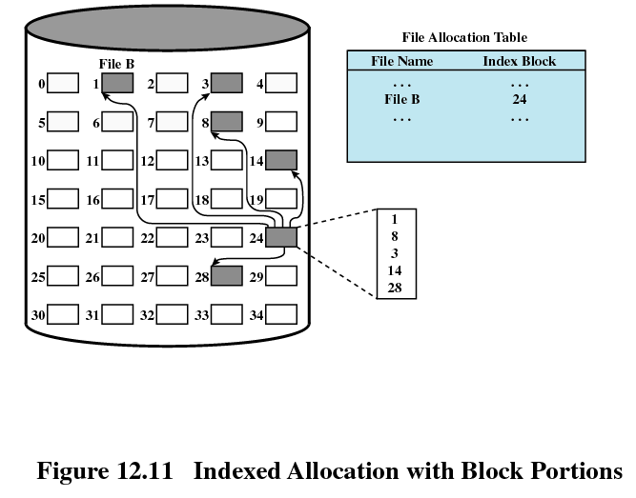
Methods of File Allocation

Slide 13
File Storage
Data storage on hard disk are stored on a magnetic flat plate
Disk’s surface needs to be partitioned and labeled so that computer can go directly to a specific point on it
Achieve by low level formatting the disk
Create magnetic concentric circles called tracks
Each track is split into smaller parts called sectors and numbered
Each sector: typically, may hold 512 bytes data
E.g. 80 tracks (from outer to inner 0 .. 79), 18 sectors disk can store 80x18x512 bytes data.

Slide 14
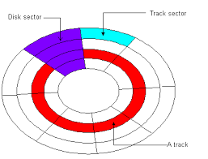
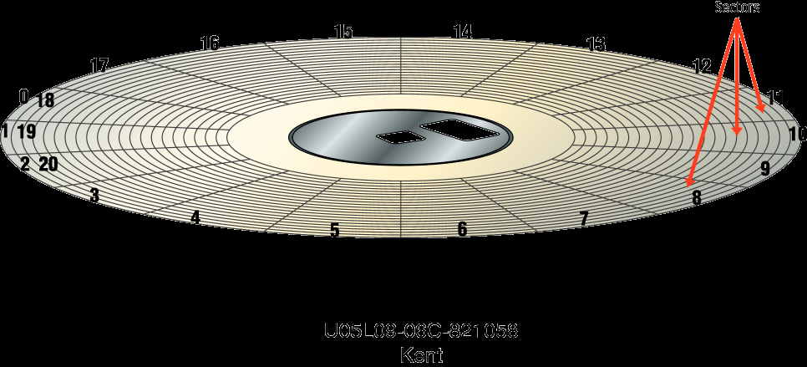
File Storage

Slide 15
File Storage
Must read or write whole sector at a time
OS allocates groups of sectors called cluster to files
Files smaller than the cluster will still be allocated the whole cluster, but the rest left unused
In Linux, every file is associated with an inode that records the location of file on the disk
The inode of all files are put together in a data structure called inode table
In the directory, every file is associated with a inode number that points to an entry of the inode table

Slide 16
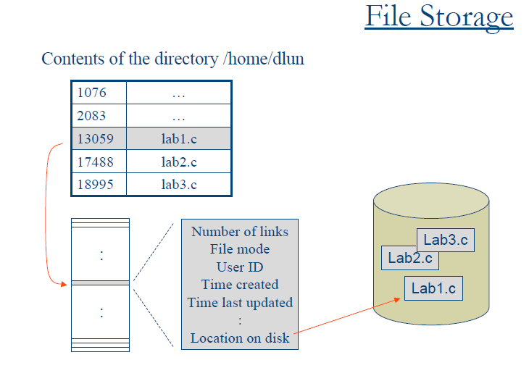
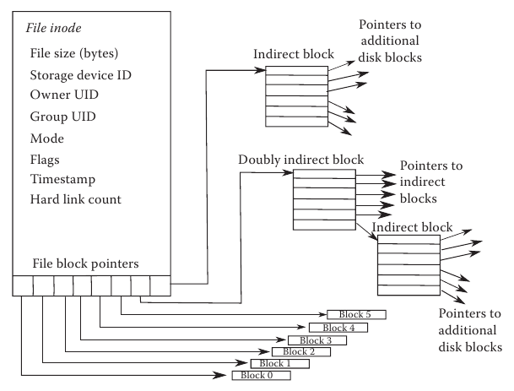

Slide 17
Reference
https://www.geeksforgeeks.org/file-allocation-methods/

Slide 18
Thanks

